Slide 1

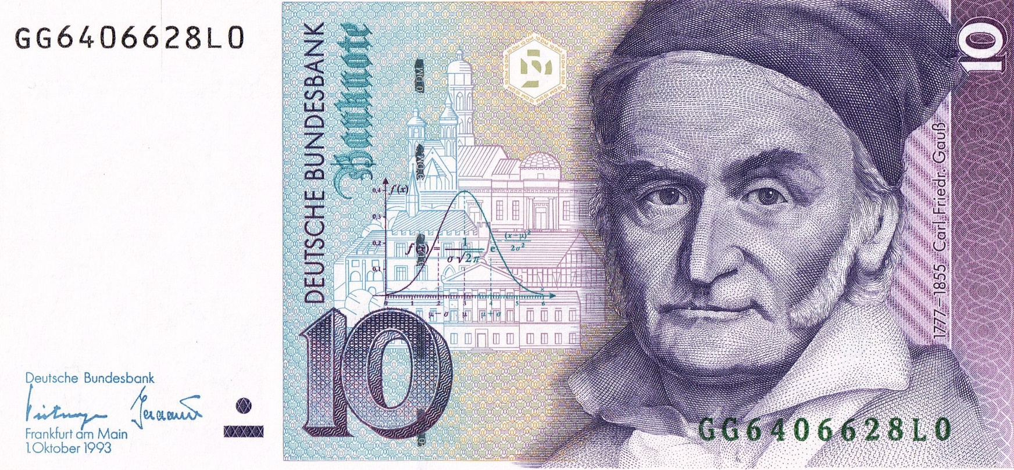
https://www.uni-goettingen.de/en/48115.html
*theory*.ppt
*theory*.ppt
UNPLAB-h²_GxE_Ch5[BredersEquation]
‘The’ Breeder’s Equation: G=h² i σ_{P}
1

Slide 2
Sequential Number: #17
UNPLAB-h²_GxE_Ch-5[BreedersEquation]
Unless I explicitly state otherwise, images and cartoons are created using ChatGPT.
You may use this material free of charge under the terms of the CC BY license. This requires that you provide appropriate attribution to the author: W. Link, University of Goettingen, Germany.
In a few cases, individual images, photographs, or similar material may be subject to a more restrictive Creative Commons license. Where this applies, it is explicitly indicated, and you must comply with the stated license terms for those items.
Please check the license information carefully before reuse. Responsibility for complying with the applicable license terms rests entirely with you.
This symbol usually indicates that a page is rather important
2

Slide 3
You already know: Population Genetics. Heritability. GxE. Selection intensity i.
Keywords of this chapter: Breeder’s Equation. Gain from Selection post-Test situation. Multistep-Selection. What-if size of nursery (i.e. number of plants) for field test is constant, plot sizes shrinks and number of genotypes correspondingly increases.
Algebra as introduced in this chapter:
G=[h²] ∙ i ∙ σ_{P} = [σ²_{G}/ σ²_{P}] ∙ i ∙ σ_{P} = [σ²_{G} / σ_{P}] ∙ i = [σ_{G} / σ_{P}] ∙ i ∙ σ_{G} = [h] ∙ i ∙ σ_{G}
h² ∝ (1 / σ²_{ME})
S ∝ σ_{ME}
σ_{ME} = variance of masking effects such as GxE and single-plot-error
3

Slide 4
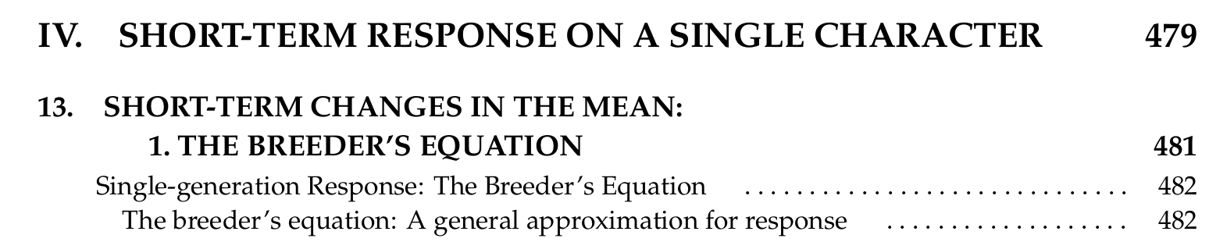
We have seen what selection intensity i may mean.
We have a good idea what phenotypic variance means.
We have a good idea what genetic variance means.
We have introduced the Selection Differential S as parameter.
We have clear clues of what h² could mean (here: Broad Sense h²).
So now, finally, last but not least, now we come to putting it all together.
We are approaching the famous, so-called Breeder‘s Equation.
Of course there is not just one equation in Plant Breeding.
Still, this is what this one is called.
Breeder‘s Equation
DOI: 10.1093/oso/9780198830870.001.0001
4

Slide 5
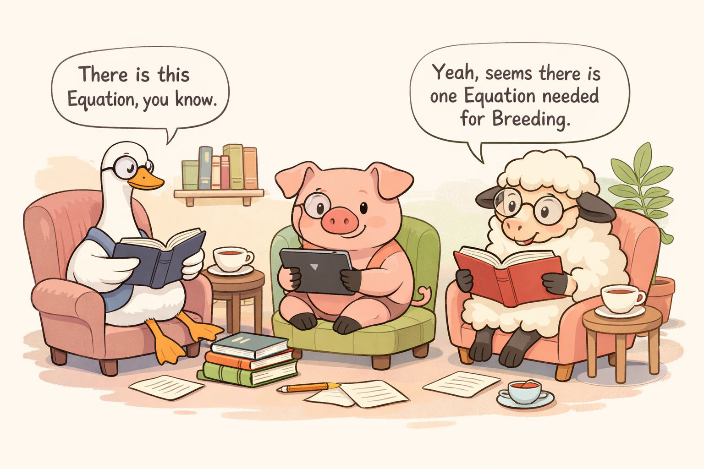

5

Slide 6
6
This equation comes in different guises, either with S or with
i ∙ σ_{P} instead of S; sometimes with genetic SD, sometimes with phenotypic SD, sometimes ‘per step of selection’, sometimes ‘per unit time’. Here written for direct selection, yet it exists as well for indirect selection. Here with broad-sense h², but it exists for narrow-sense h², too ... further variants exist. Let us see ...
https://smallgrains.web.illinois.edu/wp/wp-content/uploads/2022/09/A-practical-guide-to-genetic-gain-my-copy-2.pdf

Slide 7

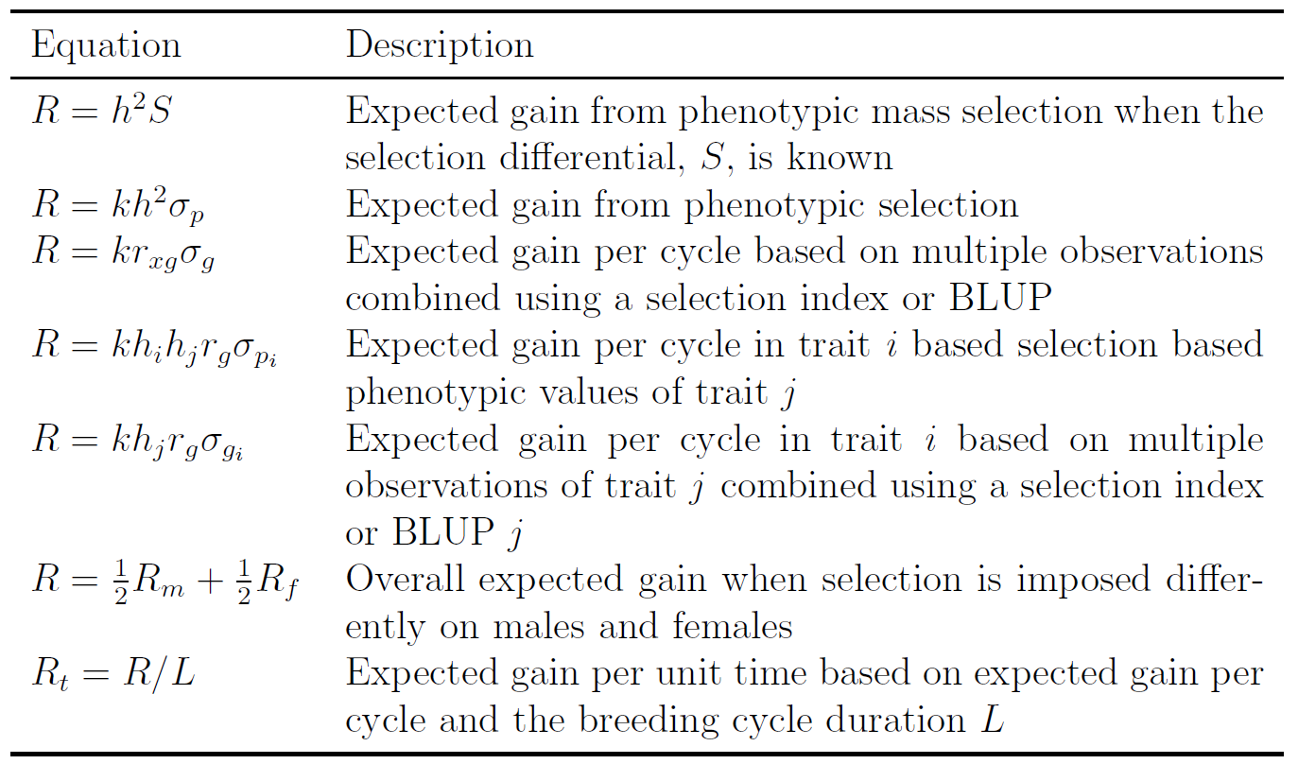
Rutkoski, Jessica E., 2019.
https://doi.org/10.1016/bs.agron.
2019.05.001
Jessica Rutkoski
@jessicarutkoski1192
At icqg6.org 2020
Danke für Erlaubnis Friday, December 19, 2025 at 8:08 AM
She writes R instead of G; and k instead of i to denote selection intensity. She prefers h² ∙ σ_{P} instead of h ∙ σ_{G}. Never mind.
Hers is the same equation as ours.
And see how many versions of it.
We will – here – not discuss all of them. Study deeper by yourself. Study the true sources, yourself!
Not pre-digested by AI ... but yourself.

7

Slide 8
Post-Test. We do have phenotypic data of our trait-under-selection and choose (select) based on them.
Entry | Yield
KT42 | 42.965
K31 | 41.776
H15 | 40.979
HF17 | 40.804
KT43 | 40.455
KT41 | 39.763
D02 | 39.685
H16 | 39.655
KT46 | 39.194
HF24 | 38.128
D03 | 37.970
H14 | 37.418
NI40 | 37.092
H09 | 36.930
HF19 | 36.668
K26 | 36.550
K32 | 36.129
K27 | 36.028
NI33 | 35.331
HF22 | 35.298
K30 | 35.236
K25 | 35.223
HF23 | 34.970
D08 | 33.933
D01 | 33.388
NI39 | 33.370
D07 | 32.853
D06 | 32.488
NI34 | 32.323
NI38 | 31.500
NI35 | 30.539
H10 | 29.824
HF18 | 28.697
H11 | 27.619
https://s.gwdg.de/lb9Gys
Post-Test, data does not perfectly follow the Normal Distribution. From data (SD=3.824) we predict (two examples for α):
Select better α = 50%, i≈0.798. Predicted Selection Differential S=3.052.
Realized Selection Differential S=3.046
Select best α = 8.82% (3 of 34).
i≈1.82. Predicted Selection Differential S=6.960.
Realized Selection Differential S=6.002.
Although we have a realized S at our disposal, we still employ h² to predict gain from selection. Realized gain from selection needs … time to validate.
8
N=34 inbred lines
7
6
5
Number of lines per class
4
3
2
1
0
25
30
35
40
45
50
Result, means at 12 Environments
8

Slide 9
The Breeder’s Equation. Here focus is on h² estimated as Gain/Selection Differential.
Phenotypic variation at one (of the E=12) environments is, as expected, larger than phenotypic variation bet-ween candidates‘ means-across E=12. When selecting 1/3 superior ones (data from one env.), then the Rea-lized Selection Differential S was 7.0 dt/ha (56.0 - 49.0). Translated into approx. true genetic data (E=12; y-axis), gain G was only 39.5-36.0 = 3.5 dt/ha.
G/S = 3.5/7.0 = 0.5 (shrinkage by half). Only half of the Selection Differential S was sustainable, durable,
realized (‚inherited‘) after testing the material across E=12 (12≈∞ ;-) ... Hence, heritability h² was h²=0.5.
Gain from Selection G = h² ∙ S
Gain from Selection G = 0.5∙7.0 = 3.5
Experimentally assessing S and then validating it via (approx.) genetic data is one option to estimate
h² ... as h² = G/S.
https://s.gwdg.de/lb9Gys
regression b = 0.5 = h²
9

Slide 10
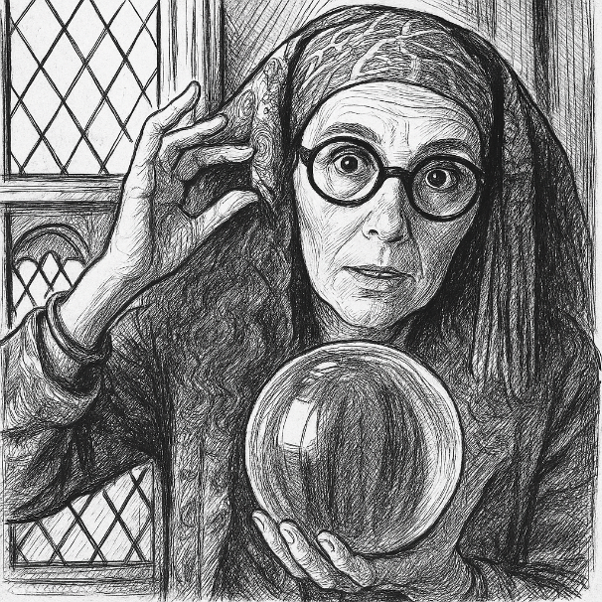
Fortune-telling. Divination. Forecasting. Estimation. Guessing. Clairvoyance. Prévisions. Déviner. Estimer. Erraten. Vorhersagen. Schätzen.
As we Employ the Breeders‘ Equation as G = h² ∙ S or
as G = h² ∙ i ∙ σ_{P}, we do not guess but we estimate.
We calculate! We do not look into the crystal ball. Still, as long as we employ estimated parameters such as σ²_{G}, σ²_{P}, h², what we do is forecasting, prediction.
Dealing with such results requires some care, and validation should be sought.
Realized h² = Genetic gain G / realized S
Estimated h² = σ²_{G}/ σ²_{P} (h² in broad sense; estimated via ANOVA)
ChatGPT. See four fin-gers no thumb ;-)
Predicted Gain from Selection is:
G=h² ∙ i ∙ σ_{P} =h ∙ i ∙ σ_{G} see below how these two guises relate to each ether
G=[h²] ∙ i ∙ σ_{P} = [σ²_{G}/ σ²_{P}] ∙ i ∙ σ_{P} = [σ²_{G} / σ_{P}] ∙ i = [σ_{G} / σ_{P}] ∙ i ∙ σ_{G} = [h] ∙ i ∙ σ_{G}
Breeder’s Equation in two guises.
Gain from Selection, predicted based on phenotypic standard deviation: G = h² ∙ i ∙ σ_{P} (e.g. G = 0.49 ∙ 0.798 ∙ 1.00)
Gain from Selection, predicted based on genotypic standard deviation: G = h ∙ i ∙ σ_{G} (e.g. G = 0.70 ∙ 0.798 ∙ 0.70)
In some tradition, you find, instead of Gain from Selection G rather Response to Selection R = h² ∙ i ∙ σ_{P} .
Whichever version of the equation you take, it never employs variance, neither genetic nor phenotypic variance.
It employs the (genetic or phenotypic) standard deviation (along with the natural [unit of the trait]; not its square).
10

Slide 11
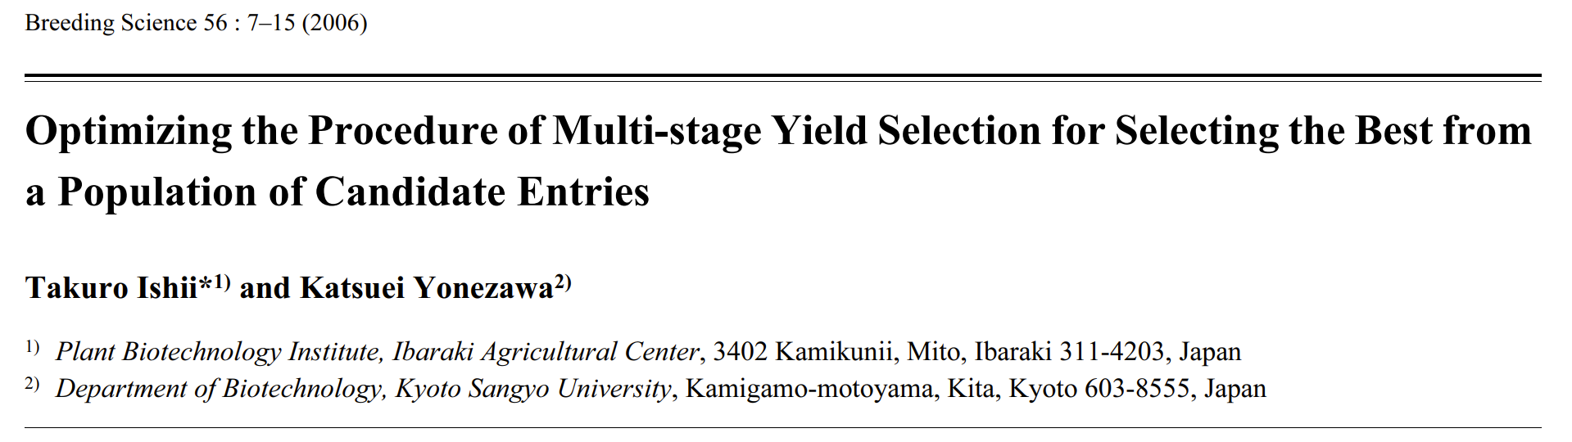

Multi-Stage Selection. Stepwise selection.
After having tested a panel of candidates in a first environment (or season) … you may either take the best ones, recombine them to release a new segregating generation, create new opportunity for transgression; or you may take the best ones and directly test them again in further environments.
This means: You need fresh propagules of them without genetic change. So, they are inbred lines, clones, or hybrids. If you worked with progenies from segregating genotypes ... then you either have remnant seed or trouble to re-test them.
If you test the selected ones ‚again‘ in a next season, then you exploit the opportu-nity to accumulate data across more than one season. You increase heritability; pro-bably you increase gain from selection.
Utz, H. F. and Schnell, F. W. (1973). Optimum number of places and optimum intensity of selection in three-stage selection processes. In: Proceedings of the First Meeting of Eucarpia, Section Biometrics in Plant Breeding, H. Rundfelt and G. Wricke (eds), 63-68. Hannover: Druckerei und Buchbinderei der Tierarzlichen Hochschule.
Hanson, W. D. and Brim, C. A. (1963). Optimum allocation of test material for two-stage testing with application of soybean lines. Crop Science 3, 43-49.
11

Slide 12
Consider Multistep Selection (Mehrstufenselektion)
Means across environments (3 locs. / year)
1. Year 2. Year 3. Year 4. Year All Ys.
*Take note, data here is ranked according to column of 1. Year.
In some breeding schemes, candidates are tested across more than one season. In a first season, several candidates will be found as con-vincingly inferior and breeders kick them out. Only those that have already been provisionally approved are tested again in a next season. This may go on across three or four seasons, even. Such Multistep Selection can be a powerful, budget-saving strategy.
Take actual data, let us employ them as example:
Select the best 12 lines according to the data of the first year.
Select among them the best 6 lines according to the second year.
Select among these the best 3 lines according to the third year.
Compare the outcome with data from testing them all across four seasons (‘All Years’ data’; this then ~ approx. true data).
When selecting among those that stayed for test in the second year, will you use their first-seasons data, too? Or will you select only based on their (ready-at-hand) second-season results? It is oftentimes challenging to have data from this season on time consistent with last season data so that the two can be merged !
12

Slide 13
We select based on first year’s results (we take α = 1/3 it means we select 12 lines).
Stepwise selection of the ‚best‘ line, in a sequence of 3 years with data from 3 locations each.
50
Have a closer look at this candidate
Select ⅓ best lines
48
according 1st year's data
KT47
46
Multistep selection is a default strategy in commercial plant breeding. After testing in season 1, you select. The selected ones are tested again in season 2, and you select again. The then-selected ones are tested again in season 3, and now you may select ultimate candidates to present to official cul-tivar release authorities (Bundessortenamt).
When conducting the selection step 2, you should include the data from season 1 (from those that were after season 1 again tested in season 2 …) instead of using only season’s 2 data; etc. For this, you need a more timely and more efficient data processing than otherwise. Is it worth it?
44
42
40
38
Mean performance across 4 years 3 locations
36
34
32
30
28
26
26
28
30
32
34
36
38
40
42
44
46
48
50
Performance in 1st year (mean of 3 locs.)
13

Slide 14
In this second step (left diagram), based on the 2nd season data, entry KT47 got lost (was not part of the better half in that season; as consequence, KT47 was not tested again in the third season). By the way: Mean performances of all candidates differed much across seasons. The season-means were: 1rst year 37.97; 2nd year 37.76; 3rd year 27.52; 4th year 41.81 dt/ha. Important message: Breeders do not go for a specific absolute performance (such as ‚yields higher than 40.0 dt/ha‘) but go for specific rank positions (such as ‚belongs to the better half‘). Fourth year was here not included for selection, but for better assessment of the candidates‘ ~true performances.
Right Diagram: Third step, based on 3rd year’s data: Take 3 best.
50
50
Select 50% best lines
Select 50% best lines
48
according 2nd year's data
KT47 lost
48
according 3rd year's data
46
46
44
44
42
42
40
40
38
Mean performance 4 years 3 locations
Mean performance 4 years 3 locations
38
36
36
34
34
32
32
See the mean values of previous seasons indi-cated by grey arrow tips
30
30
28
28
26
26
26
28
30
32
34
36
38
40
42
44
46
48
50
26
28
30
32
34
36
38
40
42
44
46
48
50
Performance 2nd year (3 locations)
14
Performance 3rd year (3 locations)

Slide 15
Left diagram: Again the approx. true data vs. 1st years data. The ultimately selected three candidates are highlighted. These ones, selected in the 3rd year, rank 2, 6, 9 (instead of 1; 2; 3). The main embarrassment was the loss of the best candidate, KT47, which ranked indeed best in season 1, but only 7th in season 2 hence ‘lost’ then.
Contemplate the third selection step (based on data in the 3rd season; right-hand diagram, same as last page)
See the stepwise gain on y-axis vs. 1rst seasons‘ results. See the two ultimate ‚winners‘ indicated.
50
50
Select 50% best lines
48
48
according 3rd year's data
46
1.
46
44
2.
44
42
3.
42
40
40
Performance 4 years 3 locations
38
38
Performance 4 years 3 locations
36
36
34
34
32
32
30
30
28
28
26
26
26
28
30
32
34
36
38
40
42
44
46
48
50
26
28
30
32
34
36
38
40
42
44
46
48
50
Performance 1st year (3 locations)
15
Performance 3rd year (3 locations)

Slide 16
Left side: Select based on current-season plus all prior seasons. We should have done it, yet, we did not. Three such steps would have led to a mean of winners (Y-axis) of 42.5 dt/ha.
Right side: Select based on current-season data alone (this we did). Three steps led to a mean of selected ones (Y-axis) of only 41.0 dt/ha.
The inbred line KT47 would not have lost in the second season if judged by its mean value across season 1 and 2, instead of judging it by second-season data alone. If selection was based on data from all four seasons (3 locations each), then even one different line would have been taken; mean of three then-best is 43.2 dt/ha.
50
50
Select 50% best lines according
Select 1/2 best lines
48
to 1rst + 2nd + 3rd year's data
48
according 3rd year's data
46
46
44
44
42
42
40
40
38
38
Performance 4 years 3 locations
Performance 4 years 3 locations
We did not discuss how to weigh data from early seasons (probably rather small plots, few replicates) vs. data from later seasons (large plots, more reps.).
10.32614/CRAN.package.selection gain
36
36
34
34
32
32
30
30
28
28
26
26
26
28
30
32
34
36
38
40
42
44
46
48
50
16
26
28
30
32
34
36
38
40
42
44
46
48
50
Performance across 3 years (3 locs.)
Performance 3rd year 3 locations

Slide 17
Multistep selection is useful, if you organize data so that fresh data is ready-to-analyse together with data from earlier years as soon as the current step of selection has to be done.
Some of the Problems* to solve:
Ultimate data set may not be orthogonal; not all candidates will be tested in all seasons; not all traits will have been assesses in all seasons. Generations may differ, e.g. in line breeding, data from F2:3-lines, F2:3-families (partial bulks) and from F2:5 (partial bulks) are judged together although plot size, replicate number, residual heterosis, plot heterogeneity of ‘same’ candidates differ across seasons. In clone breeding, data from seed-sown plants, from tuber-planted plants, from small and large plots may have to be judged in joint analyses.
*problems are sometimes named challenges, although they are still what they are.
17

Slide 18
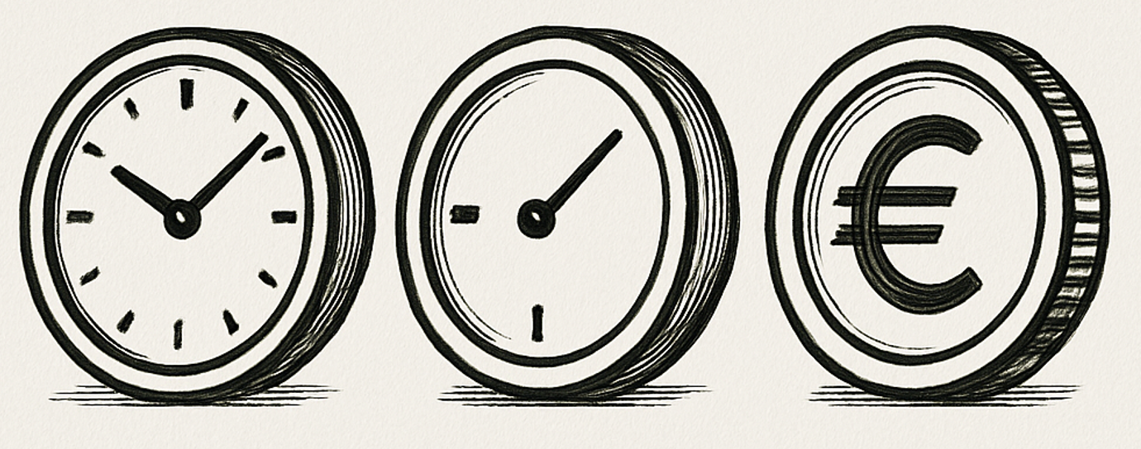
18
Rutkoski, Jessica E., 2019.
https://doi.org/10.1016/bs.agron.
2019.05.001
‚Time is money‘, a phrase popula-rized by Benjamin Franklin, one of the founding fathers of the USA.
If we achieve the same gain in half the time, then we've had double the success, haven't we?
Let us divide Gain by Time (lenght of cycle … usually counted ‚from crossing until using the improved genotypes for crossing again‘).
G = (h²∙i∙σ_{P}) / Time

Slide 19

Take this Recurrent Mass Selection scheme to contemplate Cycle Length in selection.
The scheme could be for sunflower. Assess tolerance to chilling phases in April-May. Self-fertilize superior individuals and recombine selfed offspring of selected individuals. Recombination may need one season; or is done during off-season, in greenhouse or Southern Hemisphere (I mean ‚other‘ Hemisphere).
So: Either one step of selection in two years …
or two steps of selection in two years.
We use this scheme to compare these two approaches.
To compensate the longer cycle (if we recombined in on-season), we test more candidates and select harder … than if we recombined in the off-season and select two times in two years. Use of off-season means we need additional budget. Yet, milder selection means, we test a smaller number of candidates, so we save some budget. The herita-bility might be higher if seed was produced ‚at home‘, provided seed from ‘at home’ has higher quality and is available better in time than in case of off-season recombination. Crossing at home on-season may allow some degree of selection even in this recombination step (we may kick out some non-convincing plants). All these finer considera-tions are neglected in the reasoning next page.
Self-fertilize
Recombine offspring. On-season, off-season?
Recombine*
Self-fertilize
...
Recombine*
et cetera
et cetera
*e.g. round-robin design (1x2; 2x3; 3x4 ...)
https://doi.org/10.1038/sj.hdy.6800763
19

Slide 20
Recurrent Mass Selection to illustrate diminishing return of ever harder selection.
Make things easy. Say, σ_{G} = 1 in both cases hence irrelevant for the comparison. Say, h = constant hence irrelevant for the comparison.
So, G = h ∙ i ∙ σ_{G} and here, we are only turning the screw “i”
(selection intensity).
One step in two years. Take N=10.000 candidates and α=1%, you select 100 best ones, hence i=2.665. Rigourously. G=2.665∙h∙σ_{G} .
Two steps in two years. Take N=500 candidates in each year, and α=20% (you select each year 100 best ones, hence i=1.397; less rigourously. Value for i was corrected* for N=500<∞).
The gain in two years is calculated as
G = 2 ∙ 1.397 ∙ h ∙ σ_{G} = 2.794 ∙ h σ_{G}.
In both cases, after 2 years you end up with 100 best candidates.
2.794 > 2.665, although only 2 ∙ 500 candidates were tested instead of 10.000; you see the ‘diminishing return from ever harder selection’.
cf. EiB_M2_Selection Intensity_26-10-20.pdf
Self-fertilize
Recombine offspring. On-season, off-season?
Recombine*
Self-fertilize selected individuals
Recombine*
et cetera
© GC
e.g. round-robin design (1x2; 2x3; 3x4 ...)
https://doi.org/10.1038/sj.hdy.6800763
20
*DOI 10.1093/oso/9780198830870.001.0001; page 510, equation 14.4c

Slide 21
The following pages demonstrate ... how one can apply ...
...
...
The Breeder‘s Equation
And how one
Estimates pertinent Variance Components*.
The purpose is to clarify certain ideas, reflect on things and gain valuable insights.
Invest a great deal of attention and patience, you will be rewarded in the end ;-)
*although such Var.cps. are usually only estimates and not the true values as exist in the basic pool, and … anyway is such basic pool just a projection, an anchor idea, and very rarely a reality; nevertheless, one can well learn from applying them. As long as we realize that we are only simulating the truth and not naïvely believe in the results, we should be fine.
21
21

Slide 22
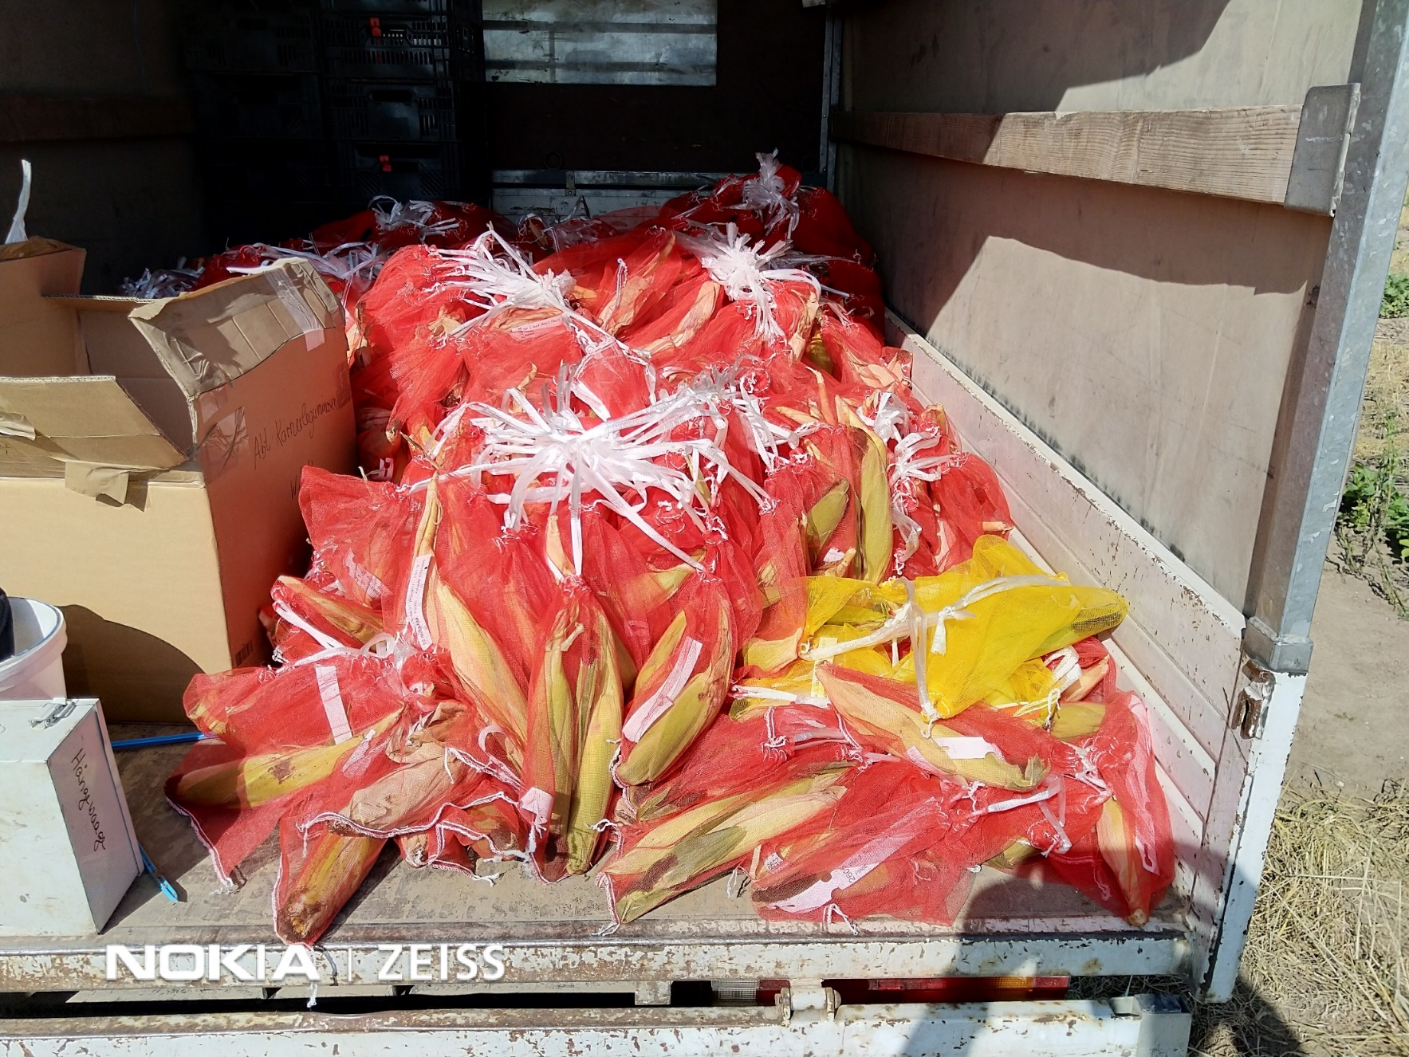
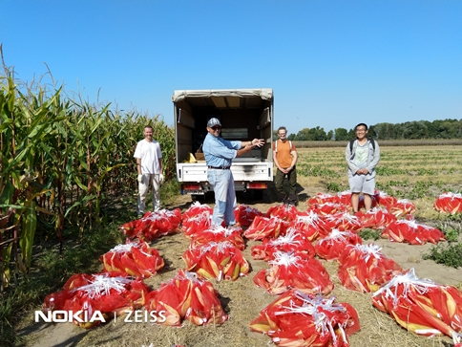
In 2021 at Reinshof*, a MSc thesis on maize was conducted, focussing on h² of phenotypic data of single plants (instead of data from plot-based assessment).
The genotypes were adapted hybrid cvs. that could be unambiguously identified by morphological traits (tassel colour and the like). They were sown in pure-stand plots and as mixture. Trait assessment was plant-by-plant. Hence, error variance could be estimated per plant, per plot, in pure stand and in mixture.
https://s.gwdg.de/vlpeAe
*51.49793942752611 9.923672376276818
© W. Link. Photo taken in times of Corona
22

Slide 23
Variance components for grain yield from DOI 10.1111/j.1439-0523.2008.01564.x
σ²_{G} =1.00; σ²_{GL} =0.3797; σ²_{GY} =0.2132; σ²_{GLY} =0.5178; σ²_{GRLY} =0.2263; σ²_{GPLYR} =12.4574
and from Wang, Y., 2021
As basis for this discussion, fix the size of the hypothetical field nursery. Test candidates at one loc. in one season with R=1. What is the impact of number of plants per field plot? Smaller plots allow for more plots (more candidates). With 1 plant per field plot, we have space for 1.000.000 candidates. With 40 plants/plot, we have 5m² plots and 25.000 candidates. With 200 plants per plot, we have 25m² plots and 5.000 candidates. Like this and so on.
Selection intensities is higher if we select best from very many compared to selecting best from less many.
Best from 5.000 => i = 3.789
Best from 25.000 => i = 4.173
Best from 1.000.000 => i = 4.948
Selection intensity „i“
Gain from selection
σ²_{PGLYR} means: Indiviudal plant’s error variance. The contribution of this variance to the phenotypic variance of candidates is expected as [σ²_{PGLYR}/N], if N is the number of plants per plot. With large N, contribution is about zero.
h = σ_{G}/σ_{P}
1
Plants/m² = 8. More plants/plot => larger plot => fewer plots in nursery
23

Slide 24
σ²_{G} =1.00; σ²_{GL} =0.3797; σ²_{GY} =0.2132; σ²_{GLY} =0.5178; σ²_{GRLY} =0.2263; σ²_{GPLYR} =12.4574
incl. Wang, Y., 2021
24
Selection intensities is higher if we select the best from many - compared to selecting the best from less many.
N= 5.000 => i = 3.789
N= 25.000 => i = 4.173
N=1.000.000 => i = 4.948
Single plot error is the larger, the less many plants per plot (the smaller each plot is).
Here, h² can not be larger than h²=0.4279 due to testing at only L=1, Y=1, R=1 (hence: h ≤ 0.6541; cf. UNPLAB-h²_GxE_Ch3[BLUP], p.10-12).
N= 5.000=> 200 p/plot => h=0.6541
N= 25.000=> 40 p/plot => h=0.6145
N=1.000.000=> 1 p/plot => h=0.2600
N=1.000.000=> 1 p/plot => h²=0.0676
With less than about 40 plants per plot, h² decreases fast, dramatically.
Selection intensity „i“
Gain from selection
h = σ_{G}/σ_{P}
In this direction, we have in-crease of plot error, of σ²_{P} , of selection intensity i, of Selection Differential S. We have de-crease of h².
1

Slide 25
σ²_{G} =1.00; σ²_{GL} =0.3797; σ²_{GY} =0.2132; σ²_{GLY} =0.5178; σ²_{GRLY} =0.2263; σ²_{GPLYR} =12.4574
N=1 => σ²_{P} =14.7945; N=43 => σ²_{P} = 2.6268
Gain from selection: G = h ∙ i ∙ σ_{G}
Maximum Gain here is with about 43 plts. per plot, i.e. 5.375m² plot size;
i= 4.1561; h²= 0.3807; h= 0.6170.
This is the more or less usual number of plants in maize nurseries ☺
Gain decreases slightly if plots get larger (from 43 plts./plot to 200 plts/plot).
You may have the following idea:
Larger plots cause smaller error vari-ance as contribution to the phenotypic variance σ²_{P} , hence smaller σ_{P} as well. Smaller plots with larger σ_{P} cause larger Selection Differentials S (remember:
G = h² ∙ S; S = i ∙ σ_{P} ) ...
which then … eventually … may lead to higher Gain from Selection.
Smaller plots = higher gain; valid idea?
Selection intensity „i“
Gain from selection
h = σ_{G}/σ_{P}
43 plants/plot, 5.375 m² /plot,
23.256 candidates in nursery.
1
N=
25

Slide 26
?
Smaller plots =? higher gain (given plot size x number of candidates = fix)? First, see how h² and how S change as σ²_{ME} change. Second, do not overlook the rôle of i.
Say: σ²_{P} - σ²_{G} = σ²_{ME*} *Masking Effects
σ²_{P} varies here only because of number of plants/plot varies.
S = i ∙ (σ²_{P})^{0.5} = i ∙ (σ²_{G}+ σ²_{ME})^{0.5}
G = h² ∙ S
h² = σ²_{G} / (σ²_{G} + σ²_{ME})
S ∝ σ_{ME} ... here not variance but SD;
h² ∝ (1 / σ²_{ME}) ... variance, not SD.
Here, h² increases inversely proportional to σ²_{ME}, whereas S increases proportio-nal to σ_{ME}.
Hence, G ∝ (1 / S ): Gain de-creases as Selection Differential in-creases. Again:
Gain decreases as S increases.
26
Selection intensity „i“
Gain from selection
h = σ_{G}/σ_{P}
Keep all else constant but increase σ²_{ME} (here: by decreasing plot size). Then you indeed increase the Selection Differential S, since σ²_{P} gets larger.
Nevertheless you decrease (not increase) Gain.
1
N=

Slide 27
σ²_{G} =1.00; σ²_{GL} =0.3797; σ²_{GY} =0.2132; σ²_{GLY} =0.5178; σ²_{GRLY} =0.2263; σ²_{GPLYR} =12.4574
S = i ∙ (σ²_{G}+ σ²_{ME})^{0.5}
G = h² ∙ i ∙ (σ²_{G}+σ²_{ME})^{0.5}
h² ∝ (1 / σ²_{ME})
S ∝ σ_{ME} ... here not variance but SD.
h² increases inversely proportional to σ²_{ME}, whereas S increases proportional to σ_{ME}.
Hence, G ∝ (1 / S ): Gain de-creases as Selection Differential in-creases.
Here, with 1 < N < 43, Gain indeed de-creases with increasing σ²_{ME}, i.e. increasing S (with decreasing N of plts/plot).
Why then, with N>43, is gain slighty decreasing with decreasing σ²_{ME},
(increasing N)?
Why is Gain not max with max. h² ?
27
Selection intensity „i“
Gain from selection
The decrease in selection intensity i, enforced by larger plots (smaller number of candidates; blue dotted line) and the ongoing decrease of σ_{ME} hence of σ_{P} at N>43 (causing decrease of S) is not any more compensated by the increase of h².
h = σ_{G}/σ_{P}
1
N=

Slide 28
Data for the plot of the last pages
The decrease in selection inten-sity i, enforced by larger plots (smaller number of candidates) and the ongoing decrease of σ²_{P} at N>43 (causing decrease of S) is not any more compen-sated by the increase of h².
Remember:
Gain = h² ∙ i ∙ σ_{P} = h² ∙ S
h² = σ²_{G} / σ²_{P} L=1; Y=1; K=1; R=1; 1 < N < 200
28
σ²_{P}=σ²_{G}+(1/L)σ²_{GL}+(1/Y)σ²_{GY}+(1/LY)σ²_{GLY}+ (1/RLY)σ²_{RGLY} + (1/N)σ²_{PGRLY)}

Slide 29

As promised, your reward for patiently going through this example of an application of the Breeder‘s Equation.
29

Slide 30
From here you may go to UNPLAB-h²_GxE_Ch-6[QTL-Detection]
30
30

